Slide 1
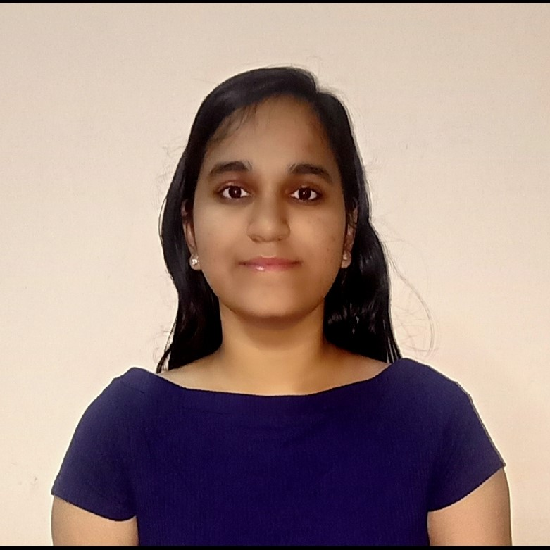
Narkhede Vijaya Dilip
Analyst/Software Engineer
Bachelor of Technology,
Computer Science Engineering : 2018-22
Skills
Mumbai
C# | Basics, OOPS, Exception Handling , Arrays ,Collection and Generics.
Angular | Components, services, Modules, Routing
.NET Framework | ADO.NET, .NET 6 WEB API, Entity Framework , ASP .NET with MVC5.
Database | Microsoft SQL Sever
Tools | GIT,VISUAL STUDIO,SSMS.
Add On Skills | Communication Skills, Time Management
vijaya-dilip.narkhede@capgemini.com
+91 9370500181
A4
Full Stack Developer
Hands on experience on C#, ADO.NET , SQL Server, ASP.NET MVC with WEBAPI
Understanding of RDBMS concepts using SQL Server.
Practical understanding of C# and SQL concepts using Visual Studio and SQL Server
Hands on experience in developing applications using ADO.NET,.NET Core
Knowledge of
Attended training on i-Transform-Microsoft . Net
ROLLOFF MANAGEMENT
Developed a WEB APPLICATION Of ROLLOFF MANAGEMENT as a part of Case Study using . Net WEBAPI , Swagger , responsive UI with HTML, CSS and Angular as a User Interface.

